Slide 1
PDA to CFG
G Sudha Sadasivam

Slide 2
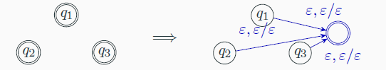
Steps
Multiple acc states convert to one
Push Z0($) into stack initially and empty stack before accepting
q0
q1
qacc
q0
ε, ε | Z0
ε, Z0 | ε

Slide 3
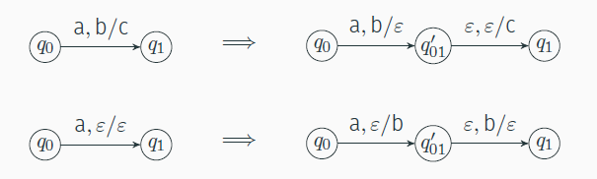
Each transition pushes / pops but not both
For every pair of states q,r add a NT / variable
A_{qr}

Slide 4
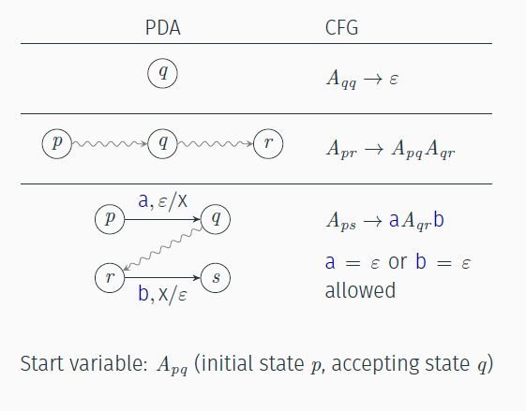

Slide 5
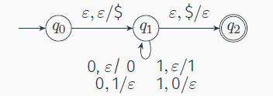
Example
A₀₂ – acc state
Other eligible states A₀₁ ,A_{12 ,} A₀₀ A_{11,} A₂₂
A₀₀ →ε A₁₁ → ε A₂₂ → ε
A₀₂ → A₀₁ A₁₂ A₀₁ → A₀₁A₁₁ A₁₂ → A₁₁A₁₂
A₁₁ → A₁₁A₁₁
A₀₂ → ε A₁₁ ε A₁₁ → 0 A₁₁ 1 A₁₁ → 1 A₁₁ 0

Slide 6
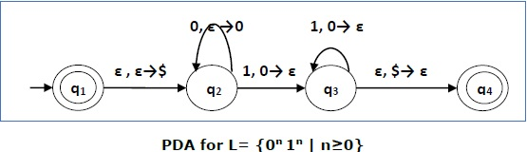
q1
n>0
States – A₁₁ A₂₂ A₃₃ A₄₄ A₁₂ A₁₃ A₁₄ A₂₃ A₂₄ A₃₄
A₁₁ → ϵ A₂₂ → ϵ A₃₃ → ϵ A₄₄ → ϵ
A₁₂ → A₁₂ A₂₂ A₁₃ → A₁₂ A₂₃ A₂₄ → A₂₃ A₃₄
A₂₃ → A₂₃ A₃₃ | A₂₂ A₂₃ A₃₄ → A₃₃ A₃₄
A₁₄ → A₁₂ A₂₄| A₁₃ A₃₄
A₁₄ → ϵ A₂₃ ϵ A₂₃ → 0 A₂₂ 1 A₂₃ → 0 A₂₃ 1

Slide 7
{0^{n} 1^{n} | n >=0}

